Slide 1
Autism Spectrum Disorder Prediction using Machine Learning
by Balamurugan M
Guide
Dr. V. Auxilia Osvin Nancy, M.Tech, Ph.D.

Slide 2
Introduction
Autism Spectrum Disorder (ASD) is a complex developmental condition characterized by difficulties in social interaction, communication, and repetitive behaviors. Diagnosing ASD traditionally requires detailed behavioral assessments and evaluations by specialists, which can be both time-consuming and subjective. These traditional methods often lead to delays in diagnosis and, consequently, in interventions that could significantly benefit individuals with ASD. Given the increasing prevalence of ASD, there is a pressing need for more efficient and objective diagnostic tools.
Machine learning, a subset of artificial intelligence, offers a promising solution to these challenges. By analyzing large datasets of behavioral and clinical information, machine learning algorithms can identify patterns and correlations that might not be evident through conventional diagnostic methods. This project investigates the potential of machine learning to predict ASD, aiming to develop models that can aid in the early detection of the disorder. Early diagnosis is crucial as it can lead to timely interventions and better outcomes for those affected by ASD.

Slide 3
Literature Survey
Autism Spectrum Disorder (ASD) is a neurodevelopmental disorder characterized by a diverse range of symptoms that profoundly impact social interaction, communication, and behaviour. Traditionally, diagnosing ASD has relied heavily on clinical observations and standardized assessments, such as the Autism Diagnostic Observation Schedule (ADOS) and the Autism Diagnostic Interview-Revised (ADI-R). While these methods are comprehensive, they are also time-consuming and heavily reliant on the expertise of clinicians for interpretation.
In recent years, there has been a growing interest in leveraging machine learning, a branch of artificial intelligence, to enhance the diagnostic process for ASD. Machine learning algorithms have demonstrated considerable potential in uncovering patterns and insights from complex datasets, offering a more efficient and objective approach to diagnosis.

Slide 4
Literature Survey
Machine learning has already made significant strides in the field of medical diagnostics across various domains, including oncology, cardiology, and neurology. Techniques such as Support Vector Machines (SVM), Random Forests, and Neural Networks have been successfully employed to analyze intricate datasets, improve diagnostic accuracy, and predict patient outcomes.
In the realm of ASD diagnosis, machine learning has emerged as a promising tool. Researchers have conducted several studies exploring the application of machine learning algorithms to predict ASD based on various data sources. For instance, Thabtah (2017) conducted a comprehensive review of different machine learning techniques applied to ASD screening data. The study highlighted the potential of machine learning in enhancing diagnostic accuracy by identifying subtle patterns indicative of ASD.

Slide 5
Literature Survey
Similarly, Duda et al. (2016) employed machine learning to analyse scores from the Autism Diagnostic Observation Schedule (ADOS) and successfully classified individuals with ASD with high accuracy. This study underscored the effectiveness of machine learning in augmenting traditional diagnostic methods and providing more precise and timely diagnoses.
These examples illustrate the promising role of machine learning in revolutionizing ASD diagnosis. By analysing large and diverse datasets encompassing demographic, behavioural, and clinical information, machine learning algorithms can uncover subtle patterns and correlations that may not be apparent through conventional methods. This capability holds significant potential for improving the accuracy, efficiency, and accessibility of ASD diagnosis, ultimately leading to better outcomes for individuals affected by the disorder.

Slide 6
Objectives
The aim of this project is to investigate the use of machine learning algorithms to predict Autism Spectrum Disorder (ASD) and to develop a model that can accurately identify individuals with ASD based on behavioral and clinical data. By analyzing extensive datasets, the project seeks to uncover patterns and correlations that traditional diagnostic methods may overlook. The ultimate goal is to create a reliable and efficient tool that supports clinicians in making more timely and accurate diagnoses. This machine learning-based approach is intended to facilitate early intervention, which is crucial for improving patient outcomes. By enhancing the diagnostic process, the project aspires to provide individuals with ASD access to necessary treatments and support at earlier stages, thereby improving their overall quality of life.

Slide 7
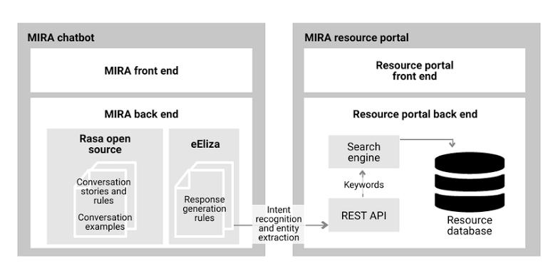
System Architecture

Slide 8
Methodology
The methodology for predicting Autism Spectrum Disorder (ASD) through machine learning involves several crucial steps to ensure the accuracy and reliability of the models developed. Firstly, the process begins with data collection, where a comprehensive dataset comprising demographic, behavioral, and clinical data is gathered from reputable sources such as the Autism Brain Imaging Data Exchange (ABIDE) and the University of California Irvine (UCI) repository. This dataset serves as the foundation for subsequent analysis and model development. Following data collection, the next step is preprocessing. This involves cleaning and normalizing the data to remove any inconsistencies or errors, ensuring that the dataset is of high quality and consistency. Preprocessing is essential for preparing the data for analysis and model training. Once the data is preprocessed, the next step is feature selection. In this phase, relevant features that significantly contribute to ASD prediction are identified. These features may include social interaction scores, repetitive behaviors, and other relevant variables that are indicative of ASD. With the selected features in hand, the model building process begins. Machine learning models using algorithms such as Support Vector Machines (SVM), Random Forests, and Neural Networks are developed and trained on the dataset. These models learn from the data and are capable of identifying patterns and relationships that can help predict ASD accurately.

Slide 9
Implementation
This project focuses on detecting Autism Spectrum Disorder (ASD) using machine learning techniques. The dataset contains various features including behavioral, demographic, and medical indicators. Initially, the data is cleaned, visualized, and preprocessed by encoding categorical variables and normalizing numerical ones. Feature engineering is applied by aggregating screening scores and transforming age into meaningful groups. To handle class imbalance, RandomOverSampler is used. The dataset is split into training and validation sets, and models like Logistic Regression, XGBoost, and Support Vector Classifier (SVC) are trained using hyperparameter tuning via GridSearchCV. A Voting Classifier ensemble (with soft voting) combines these models to enhance predictive accuracy. The performance is evaluated using ROC AUC score and confusion matrices. This system aims to assist early ASD detection by providing a data-driven diagnostic tool that can help healthcare professionals make informed decisions. It demonstrates how combining multiple algorithms can improve prediction performance for real-world classification tasks.

Slide 10
Implementation
The ASD detection system is implemented using Python libraries such as pandas, seaborn, scikit-learn, imbalanced-learn, and XGBoost. After loading and exploring the dataset, extensive visualization is conducted to understand class distribution and feature behavior. Data preprocessing involves cleaning missing values, encoding categorical data with label encoding, and scaling numerical features using StandardScaler. A new feature, `sum_score`, is created by summing individual screening test results to capture cumulative behavior. The dataset is split into training and validation sets, and oversampling is applied to balance the class distribution. Three models—Logistic Regression, XGBoost, and SVC (with probability enabled)—are trained and evaluated. Hyperparameters are optimized using GridSearchCV. An ensemble Voting Classifier with soft voting is built to leverage the strengths of all models. Evaluation using ROC AUC score reveals improved performance with the ensemble method. This approach demonstrates a robust machine learning pipeline for supporting early ASD diagnosis based on behavioral and medical input data.

Slide 11
Implementation
The project focuses on building a predictive model for Autism Spectrum Disorder (ASD) detection using machine learning techniques. Initially, data from a behavioral screening dataset is loaded and examined to identify patterns and imbalances. Various visualization techniques are applied to assess class distribution, feature relationships, and outliers. Preprocessing steps include replacing missing values, encoding categorical variables, grouping ages, and generating new informative features such as `sum_score` and `ind` for better discrimination. The dataset is split into training and testing subsets, and class imbalance is addressed using the RandomOverSampler. Feature scaling ensures uniform input to models. Multiple classifiers—Logistic Regression, XGBoost, and Support Vector Machine—are trained and evaluated based on their ROC AUC scores. A Voting Classifier ensemble is then constructed with soft voting to combine predictions and improve accuracy. The results demonstrate that model performance improves significantly when combining classifiers, making the system more reliable for early ASD prediction, which can support timely intervention and care.

Slide 12
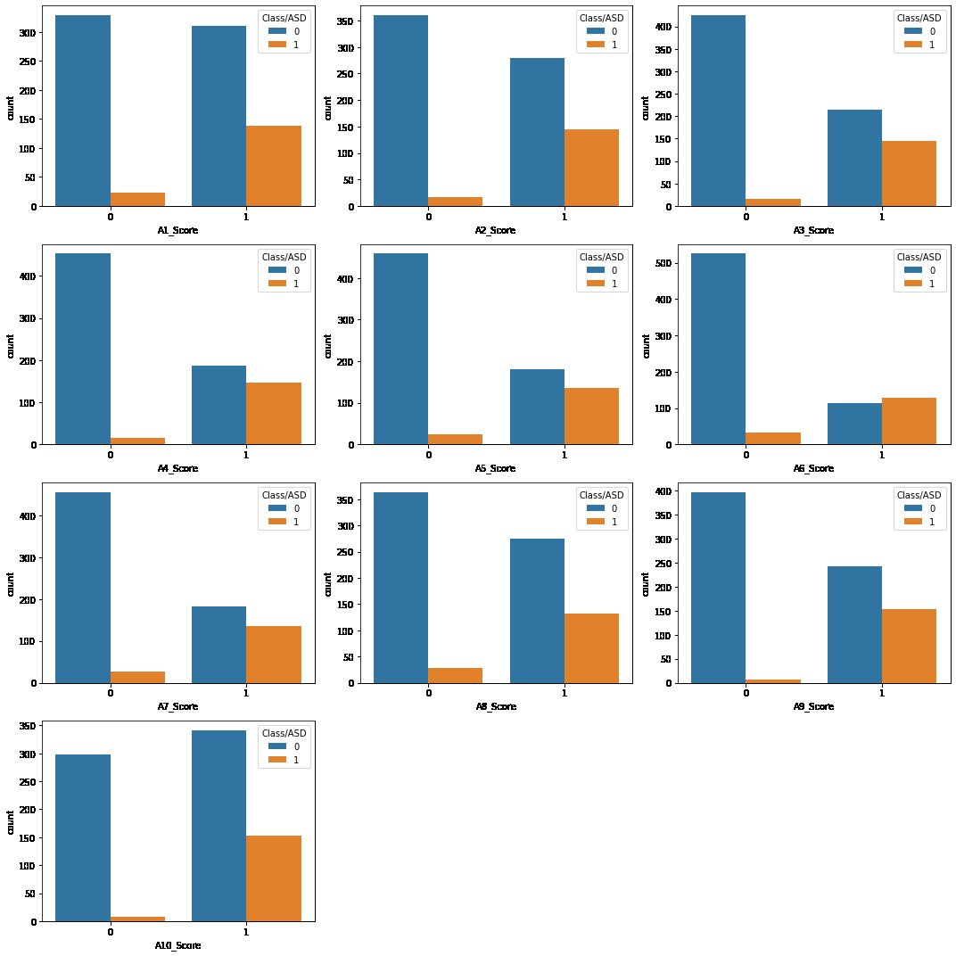
Results
Output

Slide 13
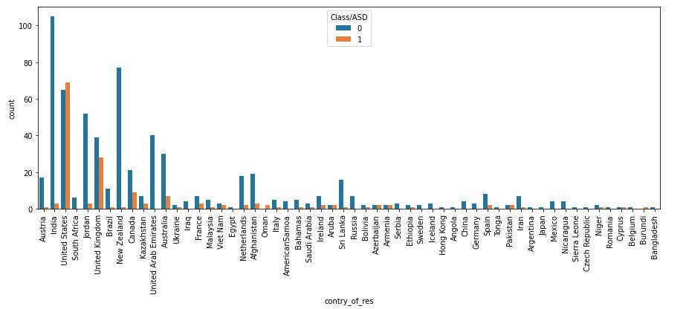
Results
Classification based on countries

Slide 14
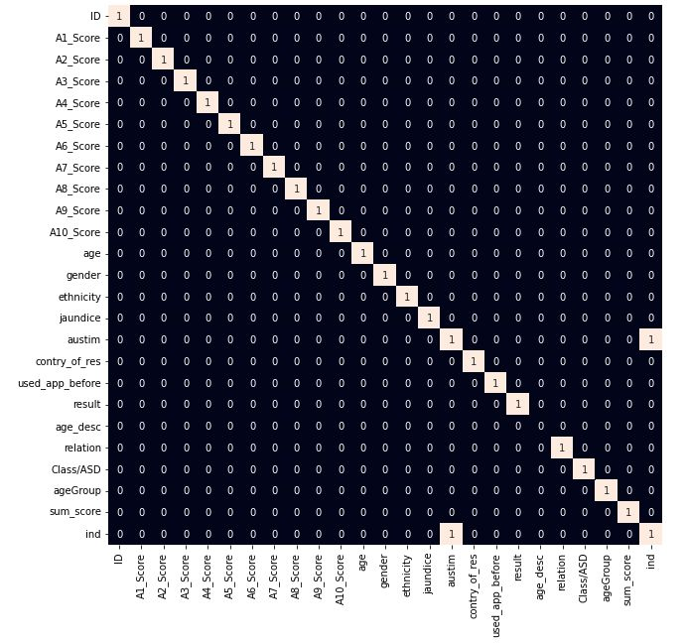
Results
Prediction Result

Slide 15
Comparison with existing work
Autism Spectrum Disorder (ASD) diagnosis presently relies heavily on clinical observations and standardized assessments, such as the Autism Diagnostic Observation Schedule (ADOS) and the Autism Diagnostic Interview-Revised (ADI-R). These procedures, while thorough, are labour-intensive, requiring specialized expertise and often leading to delays in diagnosis. Moreover, the subjective nature of these assessments can introduce variability, affecting the consistency and accuracy of diagnoses.
A critical gap exists in the availability of objective, data-driven tools for early ASD detection. Traditional methods underutilize available data, potentially overlooking crucial patterns that could facilitate early diagnosis. Machine learning presents a promising avenue for addressing this challenge. By analysing vast datasets encompassing demographic, behavioural, and clinical information, machine learning algorithms can unveil patterns that may elude conventional methods.
The integration of machine learning models into the diagnostic process offers the potential for a more standardized and objective approach to ASD diagnosis. These models can swiftly process extensive data sets, reducing diagnosis time and mitigating the inherent subjectivity of current methods. Early detection facilitated by machine learning can lead to timelier interventions, substantially enhancing developmental outcomes for individuals with ASD. By augmenting the accuracy and efficiency of diagnosis, machine learning tools have the capacity to revolutionize how ASD is identified and managed, ultimately fostering improved quality of life for those affected by the disorder.

Slide 16
Conclusion and Future Work
Conclusion:
In conclusion, the utilization of machine learning algorithms in predicting Autism Spectrum Disorder (ASD) represents a significant advancement in the field of neurodevelopmental disorders diagnosis. Throughout this comprehensive exploration, it becomes evident that the amalgamation of traditional diagnostic methods with cutting-edge machine learning techniques holds immense promise for revolutionizing ASD diagnosis, enhancing its accuracy, efficiency, and accessibility.
Future Work:
To further improve the accuracy and usability of the ASD prediction system, several enhancements can be implemented. Firstly, expanding the dataset with more diverse demographic and behavioral data from various age groups and geographic regions can help improve generalizability. Incorporating additional clinical parameters such as genetic markers, speech patterns, or EEG data could boost model precision. Transitioning to deep learning models like neural networks or ensemble methods like stacking may capture more complex patterns and relationships in the data. Integrating explainable AI (XAI) techniques would increase transparency, helping medical professionals understand why a prediction was made. Finally, periodic retraining with fresh data and user feedback will ensure the system remains current, accurate, and effective in real-world scenarios. These improvements aim to create a comprehensive, user-friendly, and clinically reliable ASD screening tool.

Slide 17
Reference
Thabtah, F., Peebles, D., Retires, C., & Early, J. (2020). A machine learning autism classification based on behavioral features. Healthcare, 8(1), 15.
Crippa, A., Salvatore, C., Perego, P., Forti, S., Nobile, M., Molteni, M., & Castiglioni, I. (2015). Use of machine learning to identify children with autism and their mothers based on gut microbiome analysis. Scientific Reports, 5, 9734.
Heinsfeld, A. S., Franco, A. R., Craddock, R. C., Buchweitz, A., & Meneguzzi, F. (2018). Identification of autism spectrum disorder using deep learning and the ABIDE dataset. NeuroImage: Clinical, 17, 16-23.

Slide 18
THANK YOU

